Slide 1




Amazon EC2 and S3
Ayushman Anupam
Amazon S3
Amazon EC2

Slide 2




Introduction
In this presentation, we will explore how
Amazon EC2 (AWS EC2)
and
Amazon S3 (AWS S3)
work, their technical aspects, benefits, and real-world applications across industries.
EC2 (Elastic Compute Cloud) and S3 (Simple Storage Service) are two of the most used services of cloud computing platform “Amazon Web Services”.
Amazon EC2 (AWS EC2) enables users to run virtual servers on demand, offering flexible computing power without the need for physical hardware.
Amazon S3 (AWS S3) is a highly scalable object storage service designed to store and manage vast amounts of data.

Slide 3


Content
Amazon EC2
Amazon EC2
History
Working
Benefits
Use cases
Industrial
Amazon S3
Amazon S3
History
Working
Benefits
Use cases
Industrial
Amazon Web Services
(AWS)
Conclusion
References

Slide 4
Amazon Web Services
Amazon Web Services (AWS) is the world’s leading cloud computing platform, offering on-demand computing, storage, and networking services to businesses, governments, and individuals.
Launched in 2006 as a subsidiary of Amazon, AWS revolutionized the IT industry by providing scalable and cost-effective cloud infrastructure, eliminating the need for traditional data centers.
AWS operates on a pay-as-you-go model, allowing users to access computing resources without upfront investments.
Its services are broadly categorized into following categories: Compute – EC2, Lambda Storage – S3, EBS Databases – RDS, DynamoDB Networking – VPC, Route 53 AI/ML – SageMaker Security – IAM, GuardDuty Analytics – Redshift, QuickSight

Slide 5
One of AWS’s key strengths is its global infrastructure, with data centers across multiple regions, ensuring high availability, reliability, and security.
Its services cater to a diverse range of applications, from web hosting and data storage to machine learning and artificial intelligence. By leveraging AWS, organizations can reduce costs, enhance security, and accelerate innovation.
AWS services cater to businesses of all sizes, from startups to global leaders like Netflix, Airbnb, and NASA, enabling scalable computing, storage, and analytics for innovation, efficiency, and growth.
In this project, we will explore two major AWS services that are widely used across industries: 🔹 EC2 (Elastic Compute Cloud): A scalable virtual computing environment. 🔹 S3 (Simple Storage Service): A highly scalable and durable cloud storage solution.
We will discuss their working principles, technical aspects, benefits, and real-world applications to understand how they empower businesses and developers.

Slide 6
Amazon EC2
Amazon EC2 (Elastic Compute Cloud) is a cloud service by AWS which provides on-demand, resizable compute capacity in the cloud.
It offers a broad selection of instance types optimized for various workloads, including general-purpose, compute-optimized, memory-optimized, storage-optimized instances, etc.
EC2 supports multiple processor architectures, such as Intel, AMD, and Arm-based processors, allowing users to choose the best fit for their applications.
Additionally, EC2 integrates with other AWS services, enabling seamless scaling and management of applications.

Slide 7
History of Amazon EC2
Amazon Elastic Compute Cloud (EC2) was launched on August 25, 2006, as one of the first services offered by Amazon Web Services (AWS).
It revolutionized cloud computing by enabling users to rent virtual servers on demand, eliminating the need for physical infrastructure.
Initially, EC2 offered a single instance type, but as demand grew, AWS rapidly expanded its capabilities.
By 2009, AWS introduced Reserved Instances, allowing customers to prepay for capacity at lower costs.
In 2010, EC2 officially moved out of beta and became a fully commercial service.
It became a fully commercial service. In 2011 it introduced Virtual Private Cloud (VPC) in 2011, which provided secure, isolated networking environments, and High-Performance Computing (HPC) instances in 2013, catering to research and enterprise workloads.
To enhance security and performance, AWS launched the Nitro System in 2018, significantly improving virtualization efficiency and hardware security.
In recent years, EC2 has continued to evolve with Bare Metal instances (2017), Graviton processors (2018) for cost-effective ARM-based computing, and inf1 instances (2019) optimized for AI and ML workloads.

Slide 8
Working of Amazon EC2
EC2 works by creating virtual versions of the hardware resources normally needed to set up a server, i.e it virtualizes CPU, storage, network and memory on computer hardware in an AWS data center.
Amazon EC2 instances are available in various types depending on a combination of memory, compute and networking resources. Every active instance launches based on preset configurations called AMIs (Amazon machine images), which can be custom or prebuilt.
EC2 instances launch into a logically isolated network called a virtual private cloud (VPC), where they stay behind firewalls called security groups.

Slide 9





Benefits of Amazon EC2
⏳ SLA Commitment
🔒⚡ AWS Nitro System
Ensures 99.9999% uptime with a robust Service Level Agreement (SLA).
Reliable infrastructure for mission-critical applications.
Enhances security, performance, and virtualization efficiency.
Provides faster networking and better resource isolation.
💰 Cost Optimization
🚀 Seamless Migration
Choose from On-Demand, Reserved, and Spot Instances to optimize costs.
Pay only for what you use, reducing infrastructure expenses.
AWS Migration Tools simplify the shift to the cloud.
Supports hybrid cloud strategies for a smooth transition.

Slide 10

Use Cases of Amazon EC2
🏢 Enterprise Applications
⚡ High-Performance Computing (HPC)
💻 macOS Development
Hosts web apps, microservices, and enterprise software.
Ensures scalability and high availability for business applications.
Provides exclusive on-demand Mac instances for Apple developers.
Enables iOS and macOS app development and testing in cloud.
Supports complex simulations.
Used for genomics, climate modeling, and financial risk analysis.
🤖 ML and AI
🎮 Gaming Servers and Streaming
🎥 Video Encoding and Processing
Trains and deploys deep learning models at scale.
Supports frameworks like TensorFlow, PyTorch, and MXNet.
Powers multiplayer online games with low latency.
Supports game streaming platforms and cloud gaming services.
Enables real-time video transcoding for streaming services.
Used by media companies for content delivery and processing.

Slide 11








Industrial
use of
Amazon EC2
FINRA - Risk Analysis & Fraud Detection
Uses EC2 for scalable risk analysis and real-time fraud detection.
Processes millions of financial transactions daily with high compute power.
Cathay Pacific - Flight Operations & Analytics
Cathay Pacific leverages EC2 for real-time flight tracking and analytics.
Improves operational efficiency.
Amazon & Shopify - Scalable Infrastructure
Uses EC2 to handle high traffic during sales events.
Ensures seamless online shopping experiences with auto-scaling.
Netflix & Disney+ - Streaming & Content Processing
Uses EC2 for high-performance video transcoding.
Supports content delivery to millions of global users with minimal latency.
Amazon EC2

Slide 12

Amazon S3
Amazon Simple Storage Service (Amazon S3) is an object storage service offered by AWS which provides industry-leading scalability, data availability, security, and performance.
Millions of customers of all sizes and industries can store, manage, analyze, and protect any amount of data for virtually any use case, such as data lakes, cloud-native applications, etc.
It has cost-effective storage classes and easy-to-use management features, which can be fine-tuned to meet specific business and compliance requirements.
A highly durable and scalable object storage service designed to store and retrieve any amount of data from anywhere on the web

Slide 13
Working of Amazon S3
Storage Structure
Data Upload & Identification
Versioning & Data Recovery
Access Control & Security
Data is stored as objects inside buckets (containers for objects).
Create a bucket, choose an AWS Region, and upload data as objects.
S3 Versioning allows multiple versions of an object to be stored.
Supports encryption (at rest & in transit).
Each object has a unique key (identifier) within the bucket.
Objects and buckets are private by default.
Each object consists of a file and its associated metadata.
Helps recover accidentally deleted or modified files.
Permissions are managed using IAM policies, ACLs, bucket policies, and S3 Access Points.

Slide 14
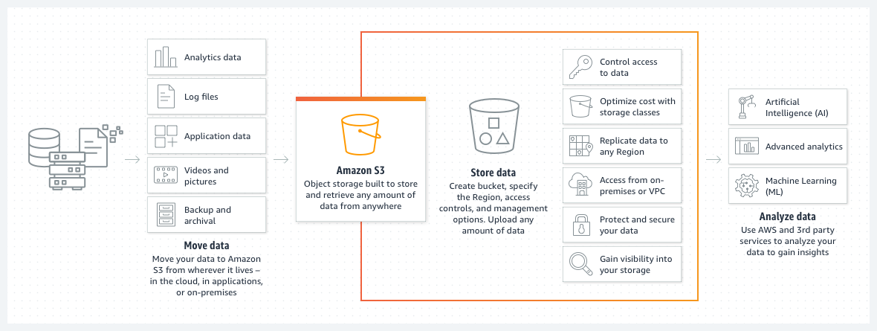
Flowchart for working of Amazon S3

Slide 15
Benefits of Amazon S3
📈Scalability
💾Durability and Availability
virtually store any amount of data
fully elastic, automatically growing and shrinking as needed
you pay only for what you use
99.9999% durability ensures data is never lost.
Data is automatically distributed across multiple geographic locations.
🔒Security and Data protection
💰 Low price and ⚡high performance
Supports encryption, access control policies, and compliance standards
Integrated with AWS IAM (Identity and Access Management) for secure access.
Pay only for what you use no upfront costs.
Optimized for high-speed data retrieval and low latency.

Slide 16
Use Cases of Amazon S3
📊 Data Lakes
🔄 Backup and restore data
📂 Archive data
Centralized repository that stores data
Can be used for data analytics, AI , ML and high-performance computing (HPC)
Provides secure, redundant storage for critical data.
Enables quick data recovery in case of failures.
Cost-effective long-term storage solution
Supports multiple retrieval options for archived files.
🌐 Static Website Hosting
🚀 Generative AI
🎥 Content Distribution and 📡 Media Streaming
Hosts static web pages, images, and scripts efficiently.
Eliminates the need for traditional web servers.
Stores vast amounts of training data for AI models.
Supports scalable and high-speed data access for AI inference.
Used by Netflix, Disney+, and YouTube for video storage.
Ensures fast and reliable media delivery worldwide.

Slide 17




Industrial
use of
Amazon S3
Netflix – Video Streaming
Stores and delivers massive video libraries with low latency.
Uses S3 to ensure seamless global content distribution.
Airbnb – Customer Data & Backup
Stores and manages millions of user-generated images and property listings.
Uses S3 for backup and disaster recovery to prevent data loss.
Tesla – Autonomous Driving & AI Training
Stores and processes vast amounts of vehicle sensor data for AI model training.
Uses S3 to manage software updates for cars over the air (OTA).
PayPal – Secure Transactions & Fraud Detection
Stores transaction logs securely to analyze patterns for fraud.
Uses S3 to archive compliance and audit data for regulatory purposes.
Amazon S3

Slide 18




Conclusion
EC2 offers flexible, on-demand virtual servers, enabling efficient computing solutions, while S3 ensures reliable, cost-effective data storage with high durability and security.
Together, these services power applications ranging from web hosting and machine learning to enterprise-level data management and disaster recovery.
Amazon EC2 and S3 are essential services in AWS, providing scalable computing power and secure storage for businesses of all sizes.
Their global availability, pay-as-you-go pricing, and seamless integration with other AWS services make them the leader in cloud computing.
By leveraging Amazon EC2 and S3, organizations can enhance performance, reduce costs, and innovate faster in today’s digital landscape.

Slide 19
References
https://aws.amazon.com/ec2/
https://www.youtube.com/watch?v=XjcefjUyBvc
https://aws.amazon.com/s3/
https://www.youtube.com/watch?v=ecv-19sYL3w
https://aws.amazon.com/what-is-aws/
https://www.sysbee.net/blog/amazon-ec2/
https://www.seagate.com/in/en/blog/what-is-s3/

